Slide 1


Computech Corporation: Advanced Job and Candidate Application
Design Specification
Simul Kadakia, Wesley Trescott, Gagandeep Singh
3/10/2015

Slide 2
Contents
Introduction
Assumptions, Constraints, and Standards
Architecture Design
System Design

Slide 3
Introduction
1.

Slide 4
Purpose
Provide a detailed description of the
Design framework
Software and hardware architecture
Security and Communication architecture
Database Design
Use cases
Sequence Diagrams

Slide 5
Definitions, Acronyms, & Abbreviations
• EJCA - Enhanced Job and Candidate Application
• User – Job seeker who uses the application
• Admin – Admin/administrator who manages the users
• Admin portal - Part of the web application that provides special facilities to Admin
• Front End - The part of the application the user interacts with
• Back End – The part of application that manages data and is managed by developers.
• UI – User Interface which is the front end of the application
• Server –Machine that will host the web application as well as database.

Slide 6
Assumptions, Constraints, & Standards
2.

Slide 7
Constraints & Assumptions
Constraints
UI based on the type of device used
Required modern internet browser such as Safari, Google Chrome, or Internet Explorer.
Assumptions
Internet connection with enough bandwidth (about 1 to 2 mbps)
Internet browser with an up to date JavaScript engine and support for HTTP cookies to remember returning user logins

Slide 8




Standard Components
Microsoft ASP.NET MVC framework
Using version 5 Razor sytax
Microsoft SQL Server
jQuery JavaScript library
Bootstrap User Interface framework
Using version 3.0 mobile first version
Components include
CSS classes
Small JavaScript library
Glyphicon image files

Slide 9
Architecture Design
3.

Slide 10
Logical View (Sys. Architecture)

Slide 11
Hardware Architecture
Webserver (Owned by Computech)
Windows Server 2008 R2 Standard
16 GB of RAM
Runs the following software:
Microsoft IIS 7.5 Webserver
Microsoft SQL Server 2008 R2 Database
User Machine
Any PC with latest version of IE, Google Chrome, Firefox or Safari
iPhone 6 and iPad Air running iOS 8.1.3
Samsung Galaxy S5 running Android v5.0 Lollipop

Slide 12
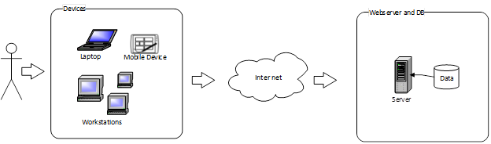
Hardware Architecture

Slide 13
Software Architecture
Microsoft’s ASP.NET MVC design pattern
Models: C# classes
3 self-written user models
Entity Framework C# classes representing db tables
Views: CSHTML files
Individual view file for each web site page, uses Razor syntax
Loaded by controller method associated
Uses Bootstrap CSS and JavaScript, as well as Jquery JavaScript
Controllers: C# classes
Interface and logic between Models and Views
UserController, JobSearchController, HomeController

Slide 14
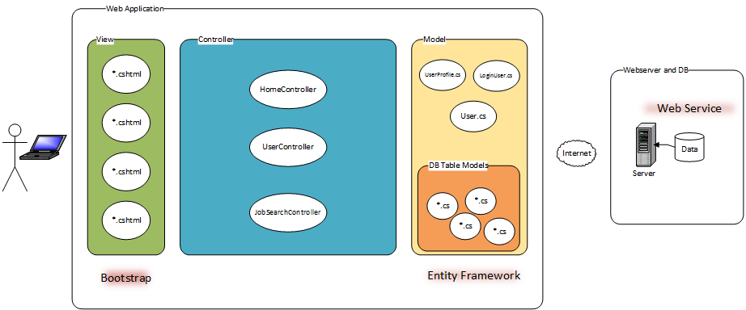
Software Architecture

Slide 15
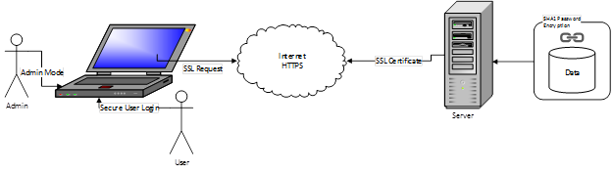
Security Architecture
The web application has the following security features:
Admin mode
SHA1 user password encryption
Email verification
Login validation
SSL encryption

Slide 16
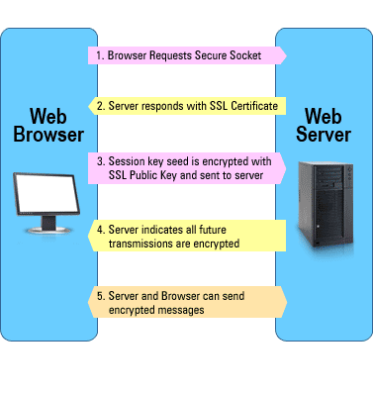
How SSL Works
Source: https://www.evsslcertificate.com/ssl/description-ssl.html
Notes:
https://www.evsslcertificate.com/ssl/description-ssl.html

Slide 17
Communication Architecture
Communication between the different components of the software system (Model, View, and Controller)
C# controller contains a C# model object which it queries for data
Data is then passed to the .CSHTML view, where it is rendered for the user to view
Communication between each of these components is handled via the .NET framework
Communication between the running application on the user’s device and the Computech server
GET (in the case of requesting a web page) and POST (in the case of submitting a form) requests from the user or admin

Slide 18
system Design
4.

Slide 19


System Design
Use Cases
Actors:
Users (Job seekers)
Admin
Search Jobs | Forgot Password
Register | Change Password
Email Verification | Profile Information
Login | Filter Jobs
Apply | Upload Resume
Login | Search Users
Deactivate Users | Delete Users

Slide 20
System Design
Use Cases Diagram:
Users:

Slide 21
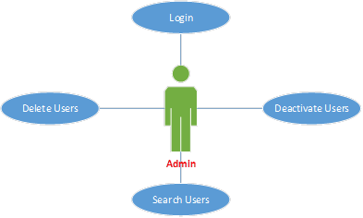
System Design
Use Cases Diagram:
Admin:

Slide 22
System Design
Use Cases
Register - Normal Flow ☺

Slide 23
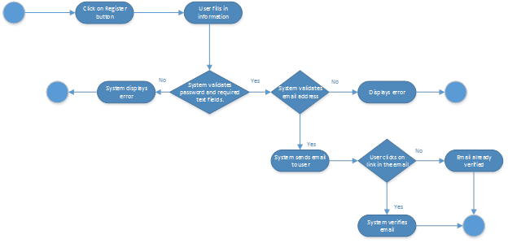
System Design
Use Cases
Register Exception ☹

Slide 24
System Design
Use Cases
Apply - Normal Flow ☺

Slide 25
System Design
Use Cases
Apply - Exception ☹

Slide 26
Database Design

Slide 27
Software Class Diagrams

Slide 28
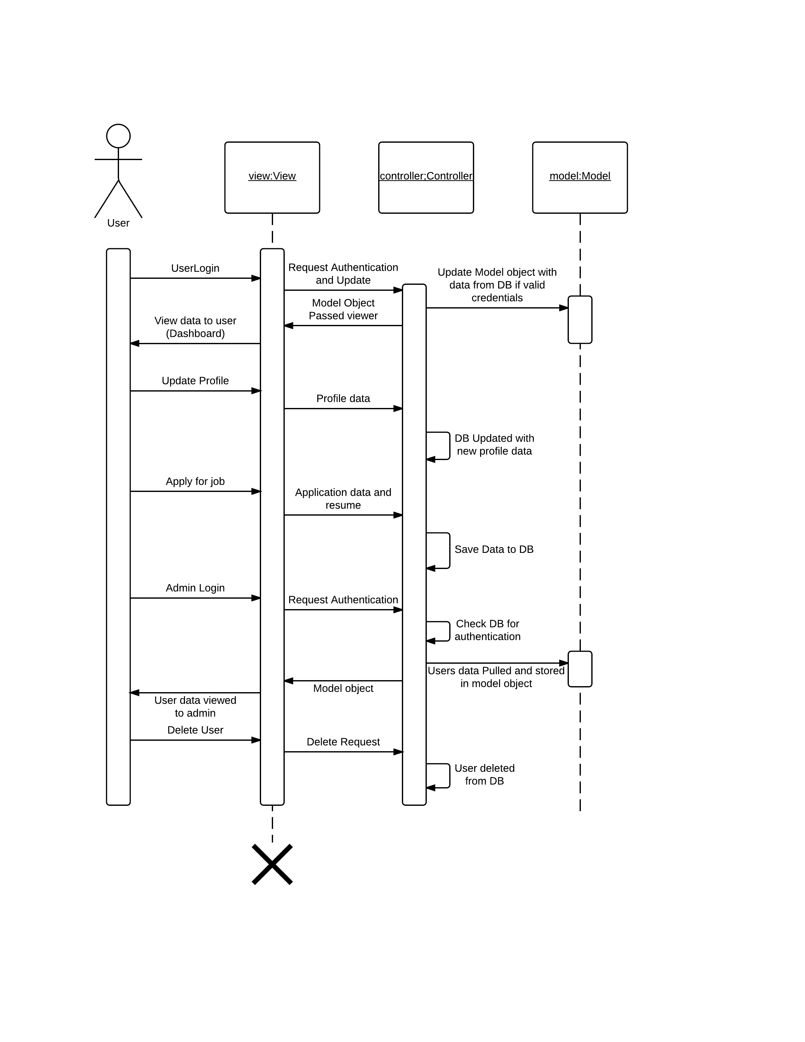
Sequence Diagrams

Slide 29
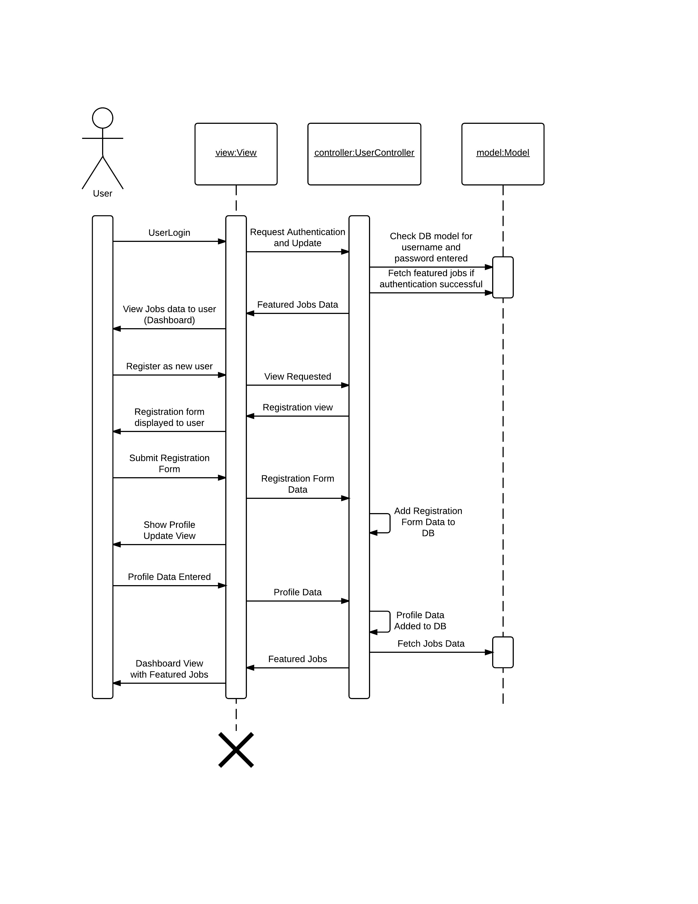
Sequence Diagrams

Slide 30
Data Flow Diagrams
Level 2 Provides in-depth view of the data flow among the various components of the web application

Slide 31
Data Flow Diagrams
Level 3-1 Shows the flow of user data in EJCA

Slide 32
Data Flow Diagrams
Level 3-2 Shows the flow of jobs data in EJCA

Slide 33
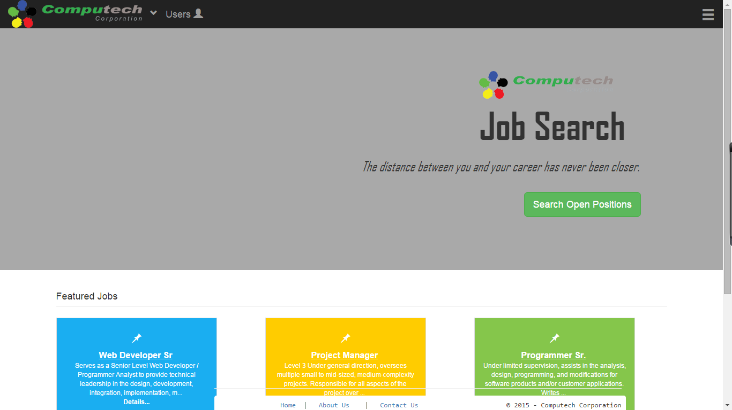
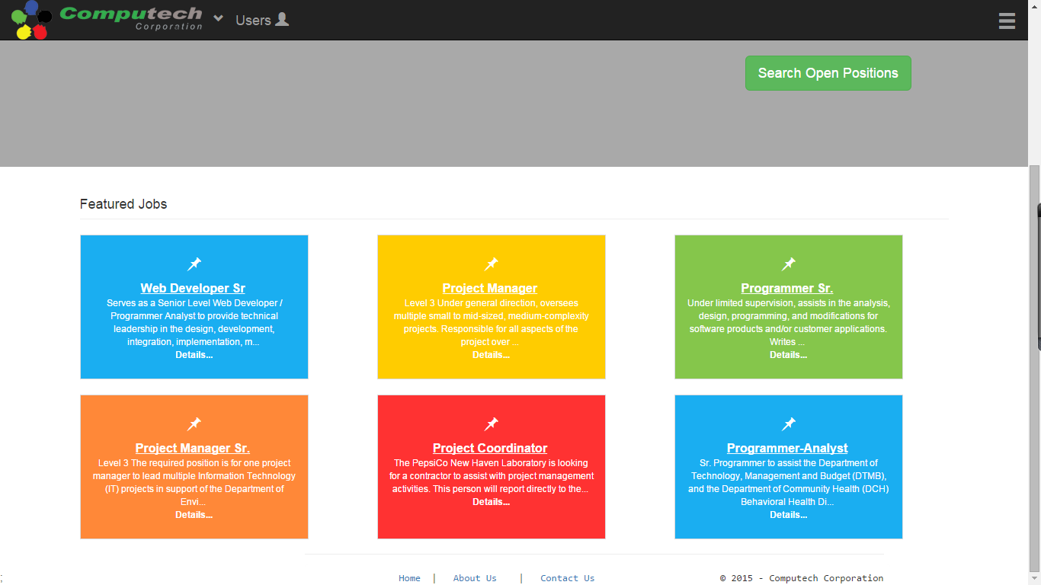
User Interface Design
4.6.1 Home Page

Slide 34
User Interface Design

Slide 35
User Interface Design

Slide 36
User Interface Design

Slide 37
User Interface Design

Slide 38
User Interface Design

Slide 39
User Interface Design

Slide 40
User Interface Design

